Slide 1
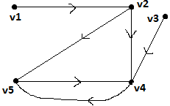
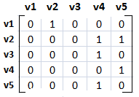
Adjacency Matrix of a diagraph
It is defined in similar fashion as it defined for undirected graph.
For Example,
A(D)=
1

Slide 2
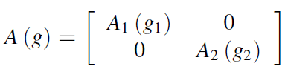
Adjacency Matrix of a diagraph
Sum of all aij in each row is equal to deg (Vi)
If sum of all aij = 0, then Vi is an isolated vertex (if 1, then pendant), (if % 2, then even, else odd).
Parallel edges between vertices will have identical columns
A disconnected graph (of two components G1, and G2 can be written in block-diagonal form:
There cannot be more than two one’s in any column of an incidence matrix (2 for normal edges, 1 for loops)

Slide 3
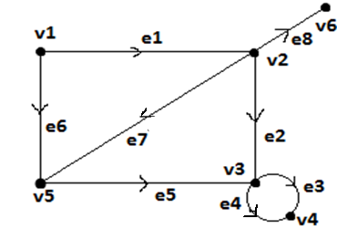
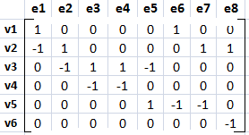
Incident matrix of diagraph
Given a graph G with n, e & no self loops is matrix x(G)=[X_{ij}] or order n*e where n vertices are rows & e edges are columns such that,X_{ij}=1, if jth edge e_{j} is incident out i^{th} vertex v_{i}
X_{ij}=-1, if jth edge e_{j} is incident into i^{th} vertex v_{i}
X_{ij}=0, if jth edge e_{j} not incident on i^{th} vertex v_{i}.

Slide 4
Circuit Matrix
Circuit can be defined as “A close walk in which no vertex/edge can appear twice”.
If edge of graph is a part of given circuit then put 1 else 0.

Slide 5
Theorem
If B is a circuit matrix, and A is an incident matrix, then every row of B is orthogonal to every row of A. In other words,
A . B^{T} = B . A^{T} = 0

Slide 6
Complete Graph
Definition: Let G be simple graph on n vertices. If the degree of each vertex is (n-1) then the graph is called as complete graph.
Complete graph on n vertices, it is denoted by K_{n}.
Theorem: In complete graph K_{n}, the number of edges are
n(n-1)/2,For example,
K₁
K₂
K₃
K₄
K₅

Slide 7
Regular Graph
Definition: If the degree of each vertex is same say ‘r’ in any graph G then the graph is said to be a regular graph of degree r.
For example,
K₃
K₄
K₅

Slide 8
Bipartite Graph
Definition: The graph is called as bipartite graph , if its vertex set V can be partitioned into two distinct subset say V1 & V2. such that V1 U V2=V & V1 ∩ V2 = ∅ & also each edge of G joins a vertex of V1 to vertex of V2.
A graph can not have self loop.

Slide 9
Bipartite Graphs
Example I: Is G1 bipartite?
v₁
No, because there is no way to partition the vertices into two sets so that there are no edges with both endpoints in the same set.
v₂
v₃
Example II: Is G2 bipartite?
v₁
v₁
v₆
v₆
Yes, because we can display G2 like this:
v₂
v₅
v₂
v₅
v₃
v₄
v₃
v₄

Slide 10
Handshaking Lemma
Theorem: The graph G with e no. of edges & n no. of vertices, since each edge contributes two degree, the sum of the degrees of all vertices in G is twice no. of edges in G.
i.e. ∑ d(v_{i})=2e is called as Handshaking Lemma.
Example: How many edges are there in a graph with 10 vertices, each of degree 6? Solution: The sum of the degrees of the vertices is 6*10 = 60. According to the Handshaking Theorem, it follows that 2e = 60, so there are 30 edges.
_{i=1}
_{n}

Slide 11
Some more Theorems
Theorem: Theorem 3
The number of vertices of odd degree in a graph is always even.
Example: How many edges are there in a graph with 10 vertices, each of degree 6? Solution: The sum of the degrees of the vertices is 6*10 = 60. According to the Handshaking Theorem, it follows that 2e = 60, so there are 30 edges.
_{n}

Slide 12
Spanning Graph
Definition: Let G=(V, E) be any graph. Then G’ is said to be the spanning subgraph of the graph G if its vertex set V’ is equal to vertex set V of G.
For Example:
G G1 G2

Slide 13
Complement of a Graph
Definition: Let G is a simple graph. Then complement of G denoted by ~G is graph whose vertex set is same as vertex set of G & in which two vertices are adjacent if & only if they are not adjacent in G.For Example:
G ~G H ~H

Slide 14
Operations on Graphs
Unary Operations:
Local changes, e.g., add/delete a vertex, add/delete an edge. Deletion implies removal of vertex, as well as all edges incident to it.
Edge Contraction: Process of removing an edge eu;v from a graph G while simultaneously merging adjacent vertices u; v into an arbitrary vertex w, such that all adjacent vertices of u are now adjacent to w, and all adjacent vertices of v are now adjacent to w.

Slide 15
Operations on Graphs
Binary Operations:
Union: of two graphs G1 = (V1; E1) and G2 = (V2; E2) is G3 = G1 [ G2, whose set is given as (V3; E3) = (V1 [ V2; E1 [ E2).
Intersection: of two graphs G1 = (V1; E1) and G2 = (V2; E2) is G3 = G1 \ G2, whose set is given as (V3; E3) = (V1 \ V2; E1 \ E2). (I.e., only includes common vertices and edges of G1 and G2)
Ring Sum: of two graphs G1 = (V1; E1) and G2 = (V2; E2) is G3 = G1 G2, whose vertex set V3 = (V1 [ V2), and edge set contains only edges of G1 and G2 that are either in G1 or G2 but not in both.
Cartesian product: of two graphs G1 = (V1; E1) and G2 = (V2; E2) is G3 = G1G2, whose vertex set V3 = V1 V2 is formed by making set V1 adjacent to set V2, and the edge set E3 is formed consequently due to vertex adjacency property.
Tensor Product: of two graphs G1 = (V1; E1), represented as an adjacency matrix [G1]mn and G2 = (V2; E2), represented as an adjacency matrix [G2]pq, is G23 = [G1] [G2], represented as a mp nq block matrix

Slide 16
Operations on Graphs
Definition: The union of two simple graphs G₁ =
(V₁, E₁) and G₂ = (V₂, E₂) is the simple graph with vertex set V₁ ∪ V₂ and edge set E₁ ∪ E₂.
The union of G₁ and G₂ is denoted by G₁ ∪ G₂.
G₁
G₂
G₁ ∪ G₂

Slide 17
Operations on Graphs
Definition: The Intersection of two simple graphs G₁ =(V₁, E₁) and G₂ = (V₂, E₂) is the simple graph with vertex set V₁ ∩ V₂ and edge set E₁ ∩ E₂.
The Intersection of G₁ and G₂ is denoted by G₁ ∩ G₂.
G₁
G₂
G₁ ∩ G₂

Slide 18
Isomorphism
Definition: Two graphs are thought of as equivalent (called isomorphic) if they have identical behavior in terms of graph theoretic properties.
Two graphs G(V, E) & G’(V’,E’) are said to be isomorphic to each other if there is one-one correspondence between their vertices & between their edges such that incidence relationship in preserved.
It is denoted by G1=G2

Slide 19
Isomorphism
For Example,
1 2 a b
4 3 d c
It is immediately apparent by definition of isomorphism that two isomorphic graphs must have,
the same number of vertices,
the same number of edges, and
the same degrees of vertices.
1
a
2
b
3
d
4
c

Slide 20
Theorem:
Two graphs G1 and G2 are isomorphic if and only if their incidence matrices A (g1) and A (g2) differ only by permutations of rows and columns.
CMSC 203 - Discrete Structures

